Slide 1
Machine Learning with ML.NET

Slide 2














Your platform for building anything
DESKTOP
WEB
CLOUD
MOBILE
GAMING
IoT
ML
.NET

Slide 3
What is machine learning?

Slide 4

Machine Learning “Programming the UnProgrammable”
{
{
Is this a face?
Price of Shirt?
f(x)
f(x)
“It has exquisite buttons … with long sleeves …works for casual as well as business settings”

Slide 5



Machine Learning “Programming the UnProgrammable”
{
Machine Learning creates a
Face
Face
f(x) Model
Not a face
Not a face
using this data

Slide 6
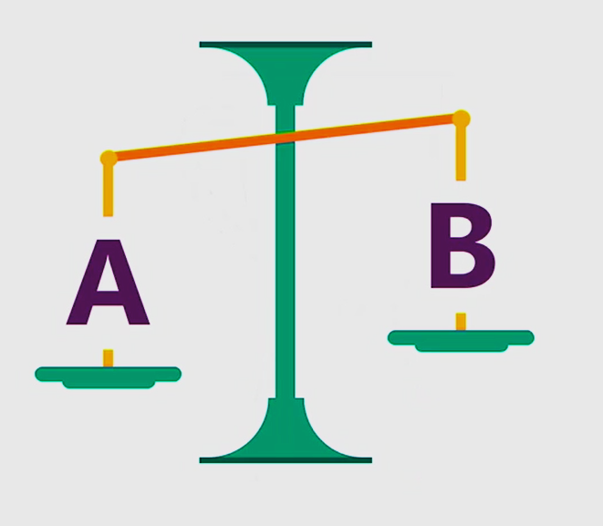
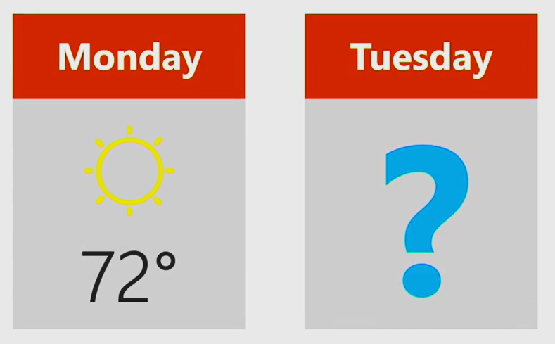
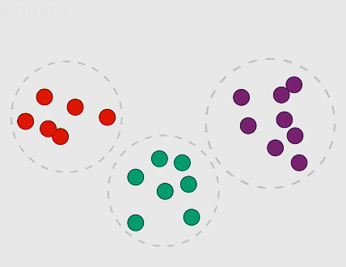
Many ML Tasks
Is this A or B?
How much? How many?
How is this organized?
Classification
Regression
Clustering
And many more…

Slide 7
What is ML.NET?

Slide 8





Pre-built machine learning models (i.e. Azure Cognitive Services)
e.g. Sentiment Analysis using Azure Cognitive Services
TextAnalyticsAPI client = new TextAnalyticsAPI();
client.AzureRegion = AzureRegions.Westus;
client.SubscriptionKey = "1bf33391DeadFish"; client.Sentiment(
new MultiLanguageBatchInput(
new List<MultiLanguageInput>()
{
new MultiLanguageInput("en","0", "This is a great vacuum cleaner")
}));
Vision
Speech
Language
96% positive
Labs
Knowledge
Search
Consume (C#, VB, F#)
Easy / Less Control
Full Control / Harder

Slide 9
Limitations with pre-built machine learning models
e.g. Sentiment Analysis using Azure Cognitive Services
TextAnalyticsAPI client = new TextAnalyticsAPI();
client.AzureRegion = AzureRegions.Westus;
client.SubscriptionKey = "1bf33391DeadFish"; client.Sentiment(
new MultiLanguageBatchInput(
new List<MultiLanguageInput>()
{
new MultiLanguageInput("en","0", "This vacuum cleaner sucks so much dirt")
}));
Vision
Speech
Language
9% positive
Labs
Knowledge
Search
Consume (C#, VB, F#)
Easy / Less Control
Full Control / Harder

Slide 10
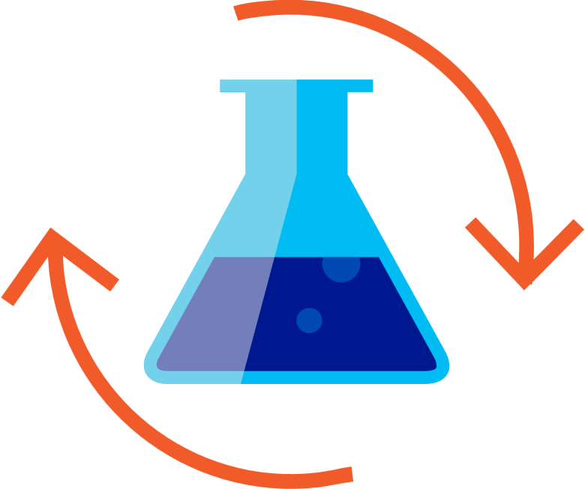

Build your own custom machine learning models
Prepare Your Data
Build & Train
Run

Slide 11



ML.NET is a framework for building custom ML Models
Developer friendly APIs for Machine Learning
Training & Consumption
Transforms
Learners
Misc.
Extensions
Text
Linear
ML Data framework
Schema
Boosted Trees
Evaluators
Missing values
Svm
Calibrators
Categorical
K-Means
Data loaders
Normalization
Feature Selection

Slide 12





ML.NET is Proven at scale, enterprise ready
Bing Ads (Ad Predictions)
Excel (Chart Recommendations)
Power Point (Design Ideas)
Windows 10 (Windows Defender)
Azure Stream Analytics (Anomaly Detection)
+ more

Slide 13




ML.NET is a machine learning framework made for .NET developers
Supported on Windows, Linux, and macOS
Build your own
Proven & Extensible
Open Source
Developer Focused
ML.NET 0.5 is available @
https://github.com/dotnet/machinelearning

Slide 14
A few things you can do with ML.NET …
Sentiment Analysis
Forecasting
Issue Classification
Predictive maintenance
Image classification
Recommendations
Object detection
Customer segmentation
And more! Samples @ https://github.com/dotnet/machinelearning-samples

Slide 15
Getting Started with Sentiment Analysis

Slide 16
Sentiment Analysis
Comment | Toxic? (Sentiment)
==RUDE== Dude, you are rude … | 1
== OK! == IM GOING TO VANDALIZE … | 1
I also found use of the word "humanists” confusing … | 0
Oooooh thank you Mr. DietLime … | 0
Features (input)
Label (output)
Wikipedia detox data at https://figshare.com/articles/Wikipedia_Talk_Labels_Personal_Attacks/4054689

Slide 17

Sentiment analysis explained
Is this A or B?
Is this a toxic comment?
Yes or no

Slide 18
Machine learning workflow
Prepare Your Data
Build & Train
Run
Load Data
Extract Features
Train Model
Evaluate Model
Model Consumption

Slide 19
Important concepts: Data
Data
Prepare Your Data
Example
Comment | Toxic? (Sentiment)
==RUDE== Dude, you are rude … | 1
== OK! == IM GOING TO VANDALIZE … | 1
I also found use of the word "humanists” confusing … | 0
Oooooh thank you Mr. DietLime … | 0

Slide 20
Important concepts: Transformer
Data
Prepare Your Data
Data
Transformer
Data
Example
Text
==RUDE== Dude, you are rude …
== OK! == IM GOING TO VANDALIZE …
I also found use of the word "humanists” …
Oooooh thank you Mr. DietLime …
Featurized Text
[0.76, 0.65, 0.44, …]
[0.98, 0.43, 0.54, …]
[0.35, 0.73, 0.46, …]
[0.39, 0, 0.75, …]
Text Featurizer

Slide 21
Important concepts: Estimator
Data
Build & Train
Data
Transformer
Data
Data
Estimator
Transformer
Example
Comment | Toxic? (Sentiment)
==RUDE== Dude, you … | 1
== OK! == IM GOING … | 1
I also found use of the … | 0
Oooooh thank you Mr. … | 0
Estimator
Model (Transformer)

Slide 22
Important concepts: Prediction Function
Data
Run
Data
Transformer
Data
Data
Estimator
Transformer (e.g. model)
Data (single row)
Prediction Function
Data (single row)
Example
Prediction Function
Comment
==RUDE== Dude, you …
Predicted Label – Toxic? (Sentiment)
1

Slide 23
Demo: Sentiment Analysis

Slide 24
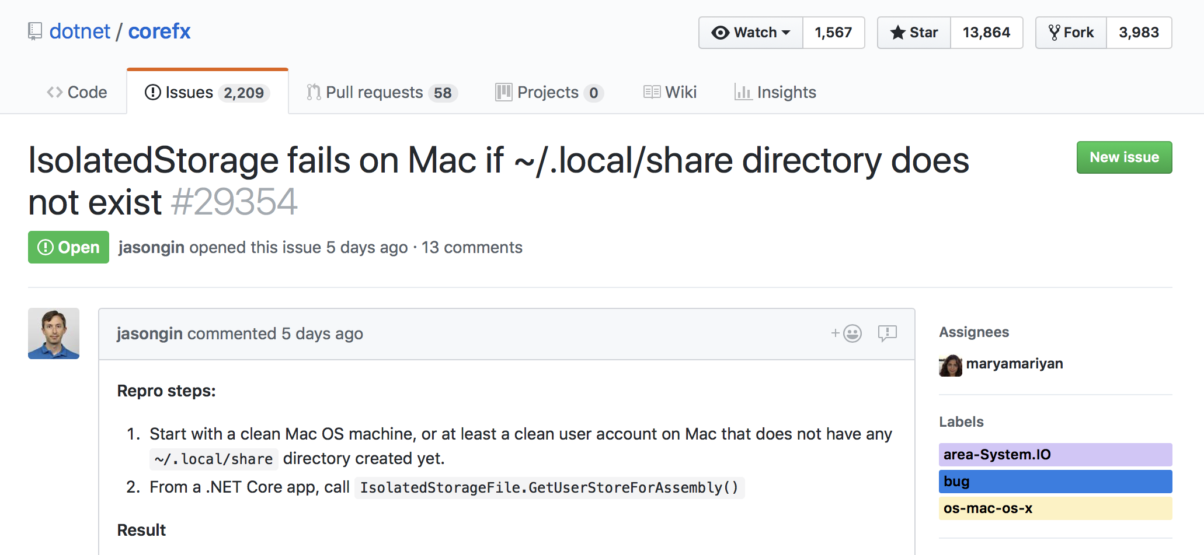
GitHub issue classification

Slide 25
Features (input)
Features
Title
Description

Slide 26
Label (output)
Label

Slide 27
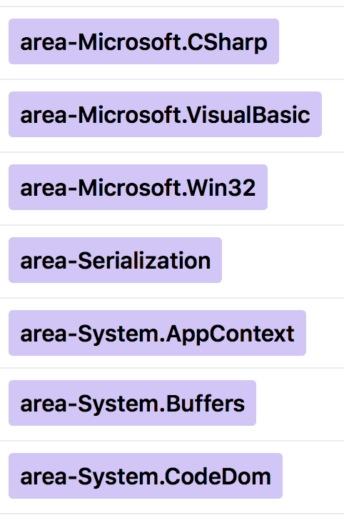
GitHub issue classification explained
Is this A or B?
Which label should this issue be assigned?

Slide 28
Demo: Issue Classification (GitHub)

Slide 29
Machine learning is iterative
Prepare Your Data
Build & Train
Run
More/different data
Larger dataset
User profiles
Different pipeline
Different learner
Different transforms
Different repositories
Different hyperparameters

Slide 30
Deep Learning

Slide 31

Deep learning
Revolutionizing areas like computer vision and speech recognition
Takes advantage of large amounts of data and compute
Image (input)
Dog
Not a dog
Dog
Not a dog

Slide 32


Deep learning with ML.NET
+

Slide 33
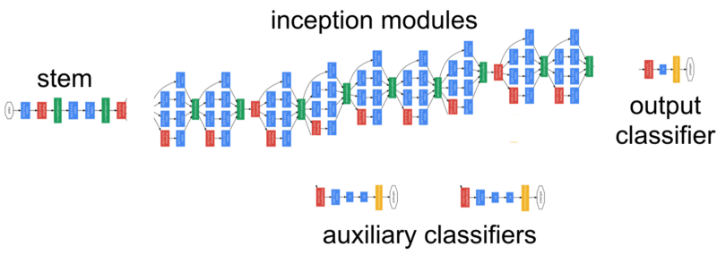

Predicting Image classes with ML.NET + TensorFlow
TensorFlow: popular deep learning framework
Pretrained model: Inception
1000 classes e.g. cats, cars, breeds of dogs
Implemented as a transformer in ML.NET
Data
Data
Transformer
Data
Data
Estimator
Transformer
Data (single row)
Prediction Function
Data (single row)

Slide 34
Image Classification Demo: TensorFlow + ML.NET

Slide 35













ONNX: Open and interoperable AI
CPU
GPU
FPGA
ASIC

Slide 36
Emotion Detection Demo: ONNX + ML.NET

Slide 37
Deep learning with ML.NET
ApplyTensorFlowGraph
+
ApplyONNXGraph

Slide 38
A few things you can do with ML.NET …
Issue Classification
Forecasting
✓
Sentiment Analysis
Predictive maintenance
✓
Image classification
Recommendations
✓
Object detection
Customer segmentation
And more! Samples @ https://github.com/dotnet/machinelearning-samples

Slide 39
ML.NET 0.6 coming soon…
ML.NET 0.1 May 2018
ML.NET 0.2 June 2018
ML.NET 0.4 Aug 2018
ML.NET 0.3 July 2018
ML.NET 0.5 Sept 2018
//Build 2018
Clustering
Cross-Validation
Collection Data Source
ML.NET samples repo
Recommendation
ONNX-ML support
Light GBM
Factorization Machines
One-versus-all
F# API improvements
SymSGD learners
Word Embedding
Light LDA
Deep Learning (TensorFlow)
API Improvements

Slide 40
What’s next with ML.NET?
API improvements
Additional ML Tasks and Scenarios
Improved Deep Learning with TensorFlow
Scale-out on Azure
Better GUI to simplify ML tasks
Improved tooling in Visual Studio
Improvements for F#
Language Innovation for .NET

Slide 41
Try ML.NET today!
Get started at http://dot.net/ml
Try the samples at http://aka.ms/mlnetsamples
Read the docs at http://aka.ms/mlnetdocs
Request features or contribute at http://aka.ms/mlnet

Slide 42
Thank you! Q & A

